Slide 1

Section 9, Team 2
ENGR1110 – Reza
Spring 2016
by Imani Malone, Keith Martin, Brent Moore, Zachary Parker, Kirsten Redmond

Slide 2
Outline
Introduction
Our design decisions (alternatives)
Our budget
Results of the competition
Challenges we faced and lessons we learned
Conclusions

Slide 3
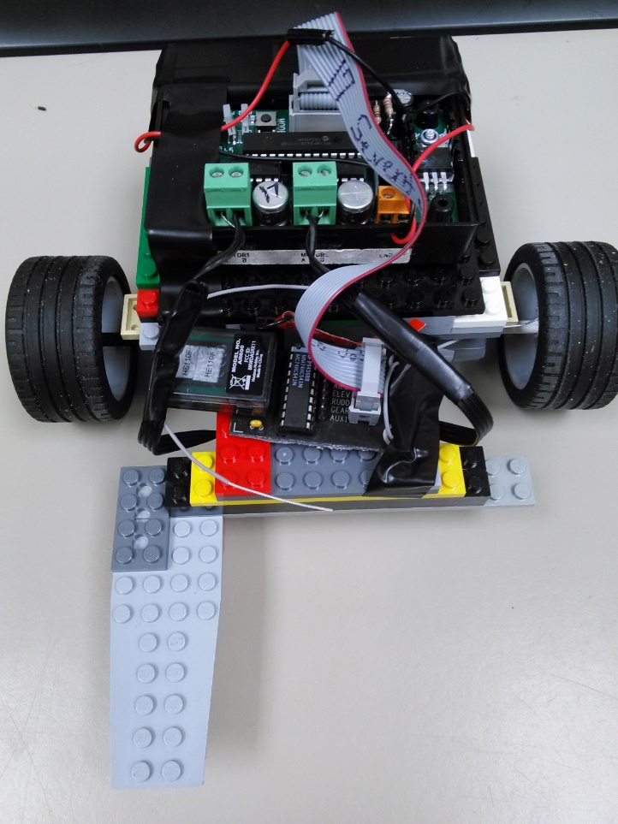
Introduction
Instructed to build a car to run a designated route
Straightforward, durable design with simple components
Front-wheel drive
Two 9 volt battery input, 9.9V output
Large wheels with sufficient torque
Strategy of completing all of the necessary and optional components
The final build

Slide 4
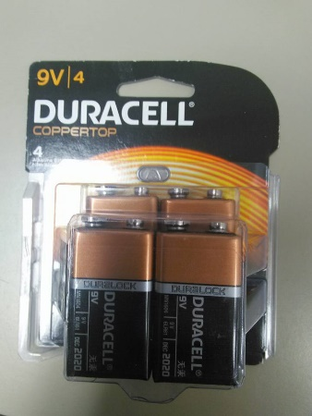
Power Supply
Criteria: longevity, weight, power, possible penalty
Two 9 volt batteries (18V supply)
Needed extra weight of 9 volts for our build due to semi-light design
Overall output was biggest concern
Also needed to ensure batteries would not run out
Pack of 9V batteries

Slide 5
Pugh Chart
Power Supply
Criteria | Importance | One 9 Volt | Two 9 Volt | Lithium Batteries
Longevity | 3 | + | ++ | --
Weight | 1 | 0 | - | ++
Power | 3 | + | ++ | -
Potential Penalty | 2 | ++ | 0 | ++
Weighted Scores |  | 10 | 11 | -3
Design Choice |  |  | X

Slide 6
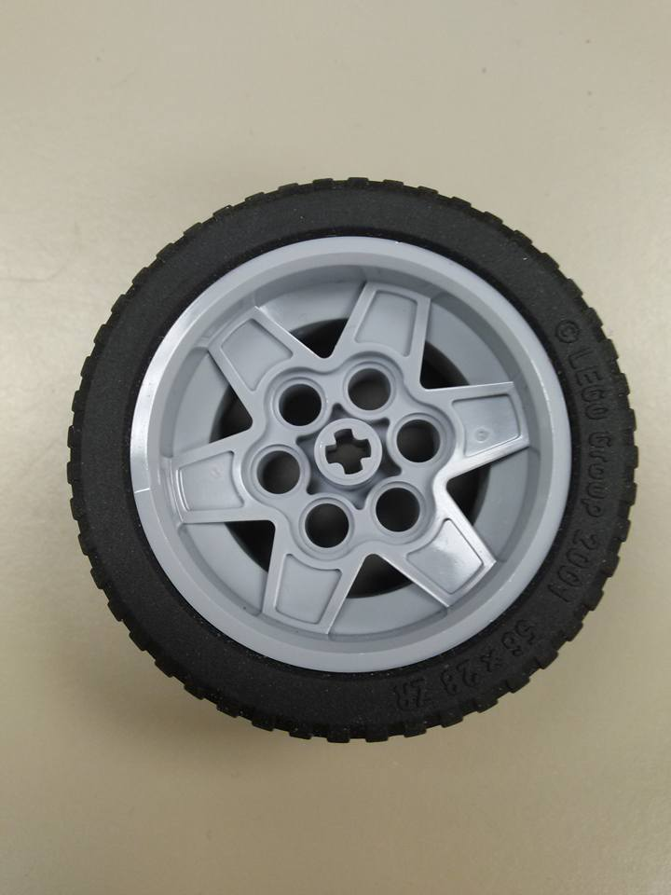
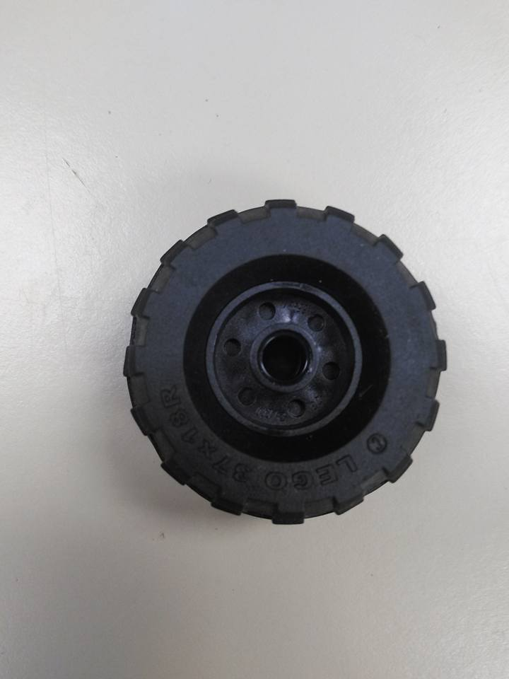
Wheel Size
First build included smaller wheels (37x18mm), which didn’t provide enough speed/block-pushing ability
Purchased larger wheels (56x28), helped tremendously
Cut time in half
Concluded that torque is more important than RPM (large > small)
Large Wheel
Small Wheel

Slide 7
Pugh Chart
Wheel Size
Criteria | Importance | Large Front Wheels | All Med. Wheels | All Large Wheels
Grip | 3 | ++ | 0 | +
Speed | 2 | + | 0 | ++
Cost | 1 | - | ++ | -
Weighted Scores |  | 7 | 2 | 6
Design Choice |  | X

Slide 8
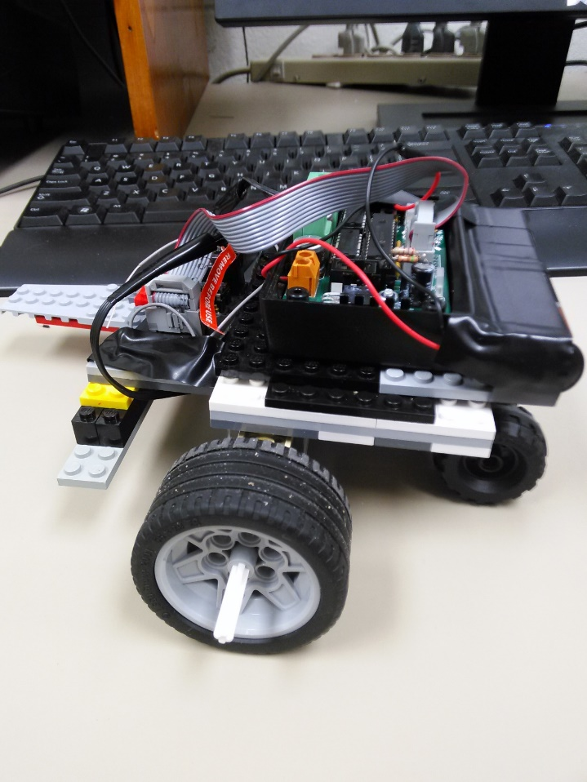
Driving Strategy
Front-wheel provides increased controllability
Rear-wheel provides stability
Our car’s build was already stable enough, needed consistency
Front-wheel drive allowed for easier steering and maneuverability
More consistent results (~10-12 secs)
Large wheels are in front

Slide 9
Pugh Chart
Driving Strategy
Criteria | Importance | Front Wheel Drive | Rear Wheel Drive
Controllability | 2 | ++ | 0
Stability | 1 | 0 | ++
Weighted Scores |  | 4 | 2
Design Choice |  | X

Slide 10
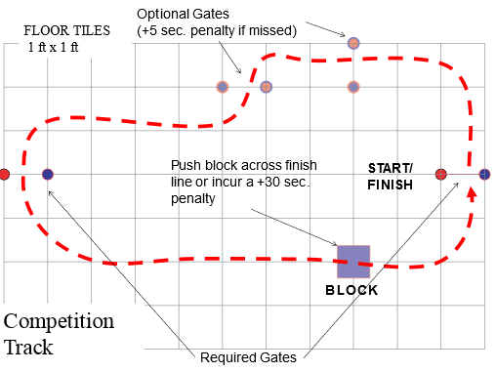
Course Path
Turning ability was sufficient enough to go through gates
Time would have increased had we skipped any optional gates
Didn’t skip block for obvious reasons, penalty too harsh
Best decision was to go through the whole course as intended
Minimize any possible penalties
The racetrack

Slide 11
Pugh Chart
Course Path
Criteria | Importance | Pass Through All Gates and Push Block | Pass Through All Gates and No Block | Miss Gates and Push block | Miss Gates and Miss Block
Time Penalty | 3 | ++ | - | 0 | --
Likelihood of Completing | 2 | - | 0 | 0 | ++
Likelihood of Survival | 2 | + | ++ | + | ++
Weighted Scores |  | 6 | 1 | 2 | 2
Design Choice |  | X

Slide 12
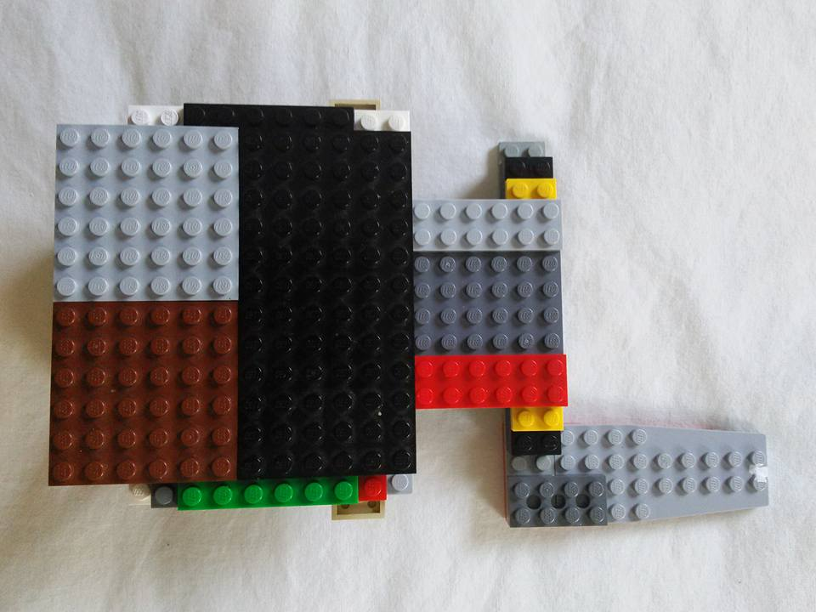
Body Types
Possible criteria: light, medium, and heavy frames
Light frame could struggle with block, which is main priority
Heavy frame could reduce speed and slow our time
Medium frame very viable, good middle ground
Small surface area but dense (respectable total weight)
Small but dense frame

Slide 13
Pugh Chart
Body
Criteria | Importance | Light | Heavy | Medium
Speed | 2 | ++ | - | +
Ability To Push Block | 3 | 0 | ++ | ++
Maneuverability | 1 | ++ | - | +
Weighted Scores |  | 6 | 3 | 9
Design Choice |  |  |  | X

Slide 14
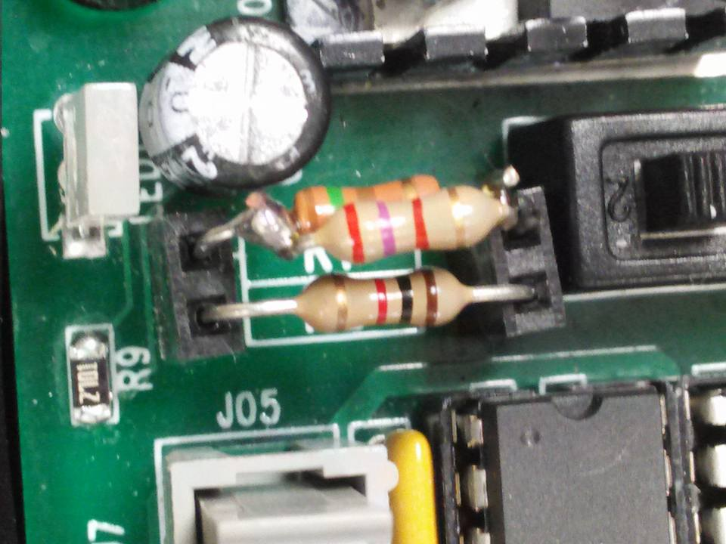
Output Voltage
Could either stay below 10 volts or go over for a penalty
Wanted to reduce penalties that weren’t necessary
Car was already strong enough to not need extra voltage
More voltage also made harder to control (less consistent)
1k and 140 ohm resistors for ~9.9V output

Slide 15
Pugh Chart
Output Voltage
Criteria | Importance | >10V | <10V
Penalties | 3 | -- | ++
Speed Consequence | 2 | + | -
Ability To Push Block | 1 | + | -
Weighted Scores |  | -3 | 3
Design Choice |  |  | X

Slide 16
Budget
Budget
Item | Price | Means of Purchase
LEGO City 4 x 4 Off Roader | $20 | Retail (Walmart)
Misc. LEGO Pieces | $10 | Online (Amazon)
LEGO Motors (2 count) | $20 | Retail (AU Science Supply Store)
Resistors | $0 (Free) | Broun (AU Campus)
9V Batteries (8 count) | $25 | Retail (Walmart)
Combination Lock | $5 | Retail (Walmart)
Exta Wheels (56x28mm, 4 count) | $30 | Online (Amazon)
TOTAL PRICE: | $110 ($22 per person)

Slide 17
Competition Results
Redesigned car night before, ended with very solid design
Results of competition still exceeded expectations
Predicted ~10-12 seconds as a good run
Competition time was 8 seconds (tie for 2nd place)
Didn’t miss any gates
Block was pushed at perfect angle (full speed)
Clean floor helped, no dust on tires

Slide 18
Challenges, Lessons & Advice
Struggled to find perfect resistors for 9.9 voltage, took searching and experimentation
Original car build fell apart at block, had to restructure
Hard to find good wheels
Advice to future students:
  Start early!
  Prepare to fork out some cash
  Start searching for parts as soon as possible, start build weeks in advance
  Don’t finish your car the night before and hope to get lucky

Slide 19
Conclusion
Design decisions:
  Two 9V battery power supply
  Large wheels, front-wheel drive
  Intended course path (no skips)
  Medium density frame
  >=10V output voltage
How to improve further:
  Rework structure to be lighter while also pushing block well
  Larger wheels possibly even more effective
  Driving practice also important to minimize total time

Slide 20

Thank you!

